Slide 1


ICLEI Emissions Calculator 2022 Update
ICLEI Inventory Categories:
Buildings and Facilities
Vehicle Fleet
Employee Commute
Solid Waste Facilities
Waste and Wastewater Treatment Facilities

Slide 2
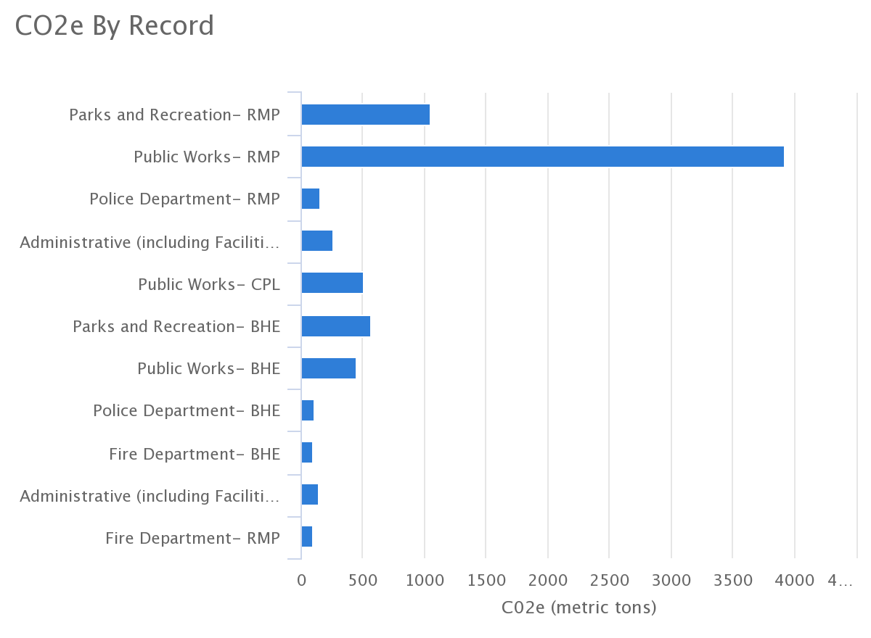
Buildings and Facilities
Data Entries:
Data collected from all utility bills (Black Hills Energy- stationary fuel combustion, Carbon Power and Light and Rocky Mountain Power- grid electricity) from each month over the course of a fiscal year for each department
Working to include offsets from solar energy production

Slide 3
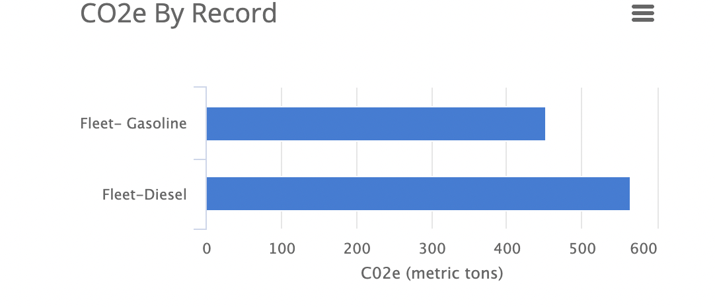
Vehicle Fleet
Data entries:
For each fuel type (gasoline and diesel)
  Total fuel consumed (gallons)
  Total VMT for passenger cars, light trucks, and heavy trucks
  Data not broken down by department for this record

Slide 4
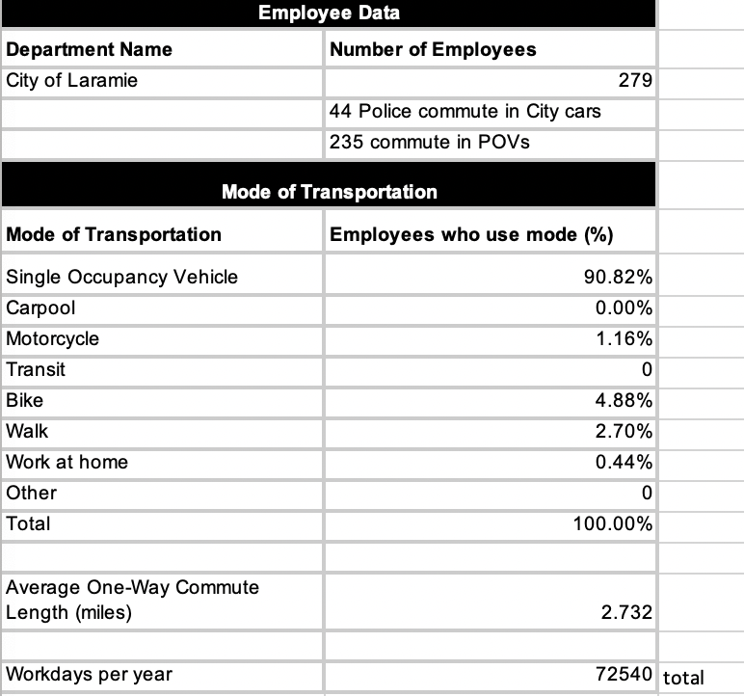
Employee Commute
Data entries:
Total gallons of fuel type used
% VMT by passenger car, light truck, heavy truck

Slide 5
Solid Waste Facilities
Data entries: total tons of waste landfilled, total tons of green waste composted, and total tons of biowaste composted
Total metric tons of CO2e: 71,133 metric tons
329 metric tons offset by green waste composting (4,728.14 tons composted)
Biowaste composting: 2,579.21 tons of biowaste composted

Slide 6
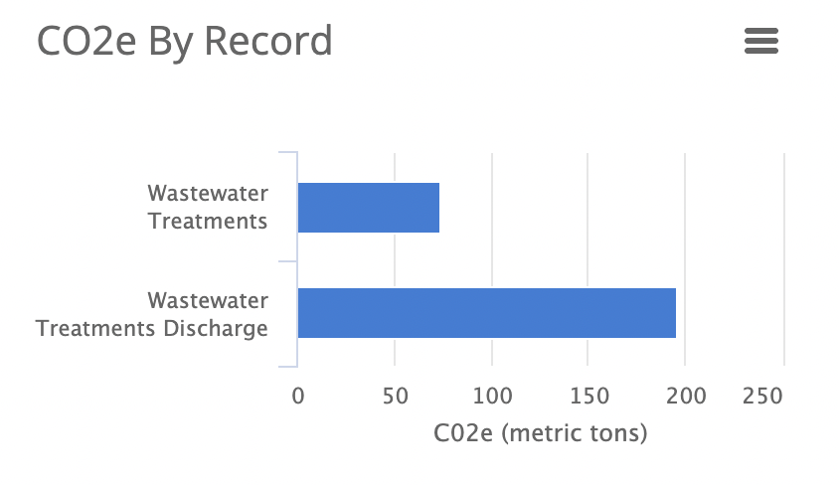
Waste and Wastewater Treatment Facilities
Data Calculations:
Process N20 Emissions from Wastewater Treatment
Process N20 from Effluent Discharge to Rivers and Estuaries

Slide 7
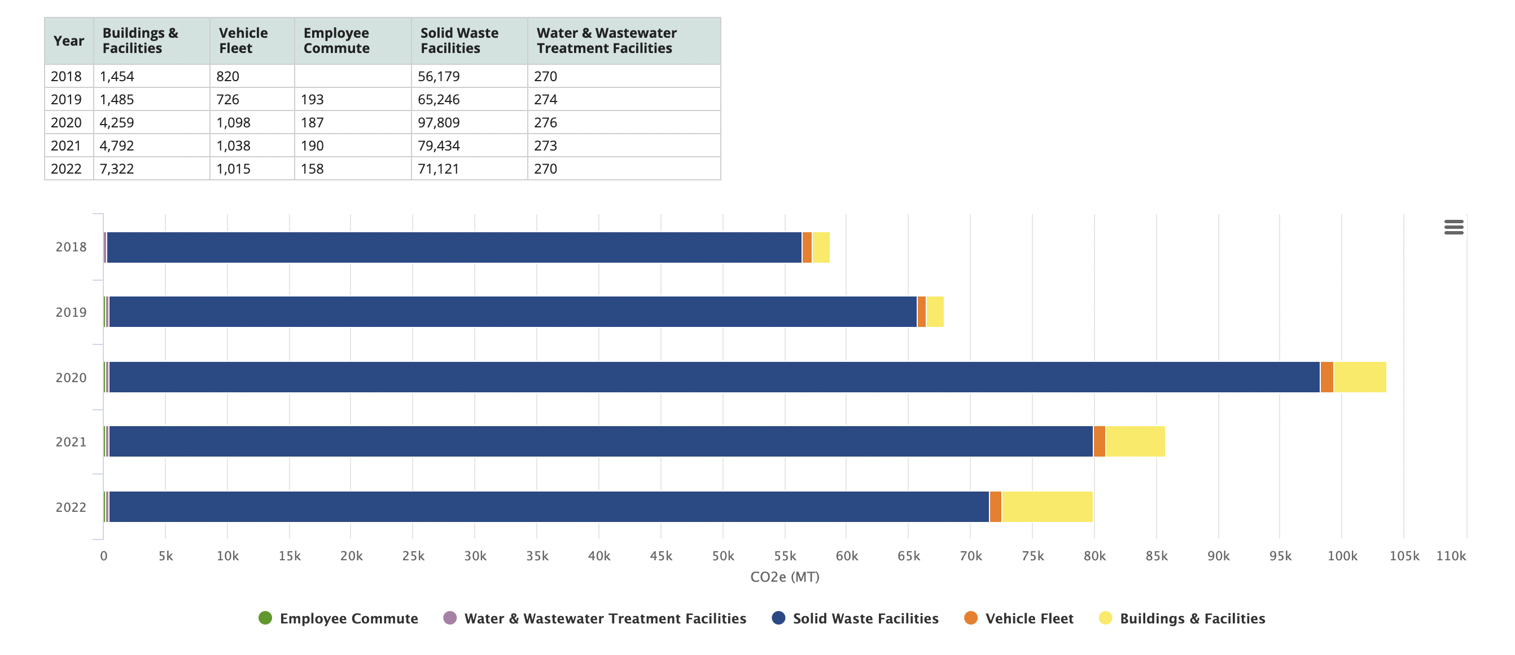

Slide 8
Emissions Reduction Plan Proposed Activities
Information Gathering/ Plan Development
Data collection for annual GHG emissions calculator
Research/literature review of emissions reduction planning case studies across WY (and Rocky Mountain West)
Interviews with stakeholders
  Informal tours with City staff and officials
  Interviews with emission planning practitioners across the state
  And more
Gather Feedback
An initial version/outline of the plan will be presented to stakeholders within the city (and county and community as necessary) to gather feedback, and/or revisions
Interviews to gather this feedback and incorporate stakeholders input into the plan
Finalize/Present Plan
Recommendations/revisions from the interviews will inform a final draft of the municipal emissions reduction plan
The plan will be presented to City Council for approval

Slide 9
Timeline
Fall/Winter, 2022
Interviews, research, plan development
Spring 2023
Drafting of first draft
June 2023
Circulate initial draft for feedback
August 2023
Finalize Initial Plan
Presentation to City Council
2023-2024 Academic Year
If possible, expand on and continue GA position through continued engagement of emissions reduction stakeholders and development of a thesis resulting from this work

Slide 10
Thank you!
Contact Info:
  Email: cscieszk@uwyo.edu
Any Questions?

